Slide 1

Analyzing Technological Trends in Autonomous Vehicles through Patent Text Mining and Predictive Modeling
Second Review
Natural Language Processing
Course Code: CS7610
Course Title: Capstone Project
Guide Name: Prof. Ramya Mohanakrishnan
24MSP3038
Aniket Shinde
13/06/2025

Slide 2
Abstract
This project presents a comprehensive analysis of the autonomous vehicle (AV) industry through patent intelligence, leveraging a novel unstructured-to-structured data pipeline that transforms raw patent text into actionable insights. Using 667 carefully filtered US AV patents from leading companies, I constructed an end-to-end NLP-to-ML framework encompassing semantic clustering, innovation trend analysis, technology emergence detection, and innovation outlier identification. The pipeline integrates advanced natural language processing techniques with machine learning models to reveal critical industry patterns including emerging technologies, declining innovations, company positioning, and strategic pivots. Through semantic clustering and temporal analysis, combined with LLM-enhanced data structuring, this work demonstrates how patent data can be systematically transformed to provide strategic intelligence for understanding technological evolution and competitive dynamics in the rapidly advancing autonomous vehicle sector.

Slide 3
Introduction
The autonomous vehicle industry represents a rapidly evolving technological landscape with billions in investments and thousands of patents annually. However, extracting meaningful insights from vast patent repositories remains challenging due to unstructured data formats and complex technical language. Existing patent analysis tools focus on bibliometric statistics but fail to capture semantic relationships and emerging innovation patterns critical for strategic decision-making.
My approach develops an integrated NLP-to-ML pipeline transforming raw patent text into structured intelligence. Through semantic clustering, temporal trend analysis, and LLM-enhanced processing, I create a comprehensive framework for understanding AV technological evolution. This work contributes a novel methodology revealing company positioning, emerging technologies, and innovation outliers. In an industry where technological leadership determines market success, this system provides unprecedented visibility into competitive dynamics, enabling data-driven decisions about R&D investments and strategic positioning.

Slide 4
Need of study
Strategic Investment Decisions: Companies need to identify white spaces and avoid patent thickets when allocating R&D budgets, requiring deep understanding of technological trajectories and competitive positioning in the AV landscape.
Real-time Competitive Intelligence: Traditional patent analysis methods are too slow for the fast-paced AV industry, where technological breakthroughs can shift market dynamics within months rather than years.
Cross-domain Technology Transfer: AV patents span multiple disciplines (AI, sensors, mechanical systems), necessitating semantic analysis to identify unexpected innovation patterns and cross-pollination opportunities between different technical domains.

Slide 5
Problem Statement
Patents represent critical early indicators of technological innovation, yet their unstructured format limits strategic intelligence extraction in fast-moving industries like autonomous vehicles. Traditional patent analysis relies on manual review or simple keyword searches, failing to capture semantic relationships and temporal dynamics essential for understanding technology evolution. This project addresses the challenge of transforming unstructured patent text into actionable intelligence through an integrated NLP-to-ML pipeline. By combining semantic clustering, trend analysis, and LLM-enhanced structuring, we systematically extract innovation patterns, identify emerging technologies, and detect strategic pivots across 667 AV patents from leading companies. The objective is to demonstrate how advanced text analytics can enable real-time competitive intelligence, support innovation outlier detection, and inform strategic R&D decisions in the rapidly evolving autonomous vehicle ecosystem.

Slide 6
Objectives
General Objective
To develop an integrated NLP-to-ML pipeline for transforming unstructured AV patent data into structured intelligence that enables strategic decision-making and competitive analysis in the autonomous vehicle industry.
Specific Objectives
Data Infrastructure Development: Construct a comprehensive dataset of 667 US AV patents with full-text extraction, metadata preprocessing, and structured storage in JSONL format for downstream analysis.
Semantic Pattern Discovery: Apply advanced NLP techniques including SBERT embeddings, UMAP dimensionality reduction, and clustering algorithms to uncover hidden technological relationships and patent groupings.
Temporal Innovation Analysis: Implement trend analysis methodologies to identify emerging and declining technologies, measuring innovation trajectories across time periods using curated AV-specific terminology.
LLM-Enhanced Structuring: Leverage Gemini API to transform unstructured patent text into machine-interpretable features including novelty aspects, problem-solution mappings, and categorical classifications.
Strategic Intelligence Extraction: Deploy Prophet-based emergence analysis, anomaly detection algorithms, and similarity matching to identify innovation outliers, strategic pivots, and competitive positioning insights.

Slide 7
Related Work
Trappey et al. (2020) established foundational work in intelligent patent summarization using ML and NLP techniques, demonstrating automated transformation of unstructured patent text into structured insights. Cho et al. (2021) specifically examined autonomous driving patents through citation analysis, validating strategic importance of AV patent intelligence. Kim & Bae (2017) introduced forecasting methodologies for identifying promising technologies through patent analysis, aligning with my trend analysis components. Lattimer et al. (2023) contributed advanced NLP techniques for processing long documents, relevant to my full-text patent analysis pipeline. My work extends these foundations by integrating semantic clustering, LLM-enhanced structuring, and emergence detection into a comprehensive NLP-to-ML framework, moving beyond citation-based analysis to capture deeper technological relationships and innovation patterns in the AV domain.

Slide 8
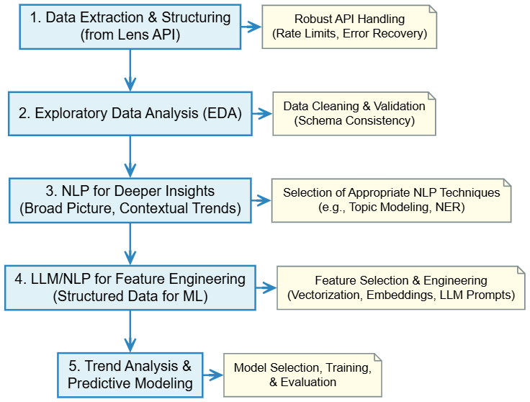
Proposed Methodology

Slide 9
Proposed Methodology [ Max. 3 Slides ]
Data Pipeline & Semantic Analysis
Data Acquisition & Preprocessing: Filter 667 US AV patents from Lens.org using CPC codes and company criteria, acquire full-text via Lens API, structure in JSONL format with metadata normalization and attribute optimization.
Semantic Corpus Construction: Load preprocessed patents, create semantic representations using SBERT embeddings, apply UMAP dimensionality reduction for optimal clustering preparation.
Patent Clustering & Visualization: Perform semantic clustering to identify technology groups, extract cluster keywords, generate visualizations showing patent distributions by company and technology domains.
Similarity Analysis: Implement patent-to-patent similarity matching and cluster relationship analysis to reveal technological connections and competitive positioning.

Slide 10
Proposed Methodology [ Max. 3 Slides ]
Temporal Analysis & Intelligence Extraction
Innovation Trend Analysis: Create temporal corpus with curated AV-specific terminology, extract meaningful n-grams, perform trend analysis to identify emerging and declining technologies.
LLM-Enhanced Structuring: Deploy Gemini API with structured prompts to transform unstructured patent text into machine-readable features including novelty aspects, problem-solution mappings, and categorical classifications.
Technology Emergence Detection: Apply Prophet forecasting model with custom emergence scoring methodology to identify breakthrough technologies and calculate growth rates.
Innovation Outlier Analysis: Combine NLP vectorization, DBSCAN clustering, and isolation forest algorithms to detect radically innovative patents, strategic pivots, and innovation leadership patterns.

Slide 11
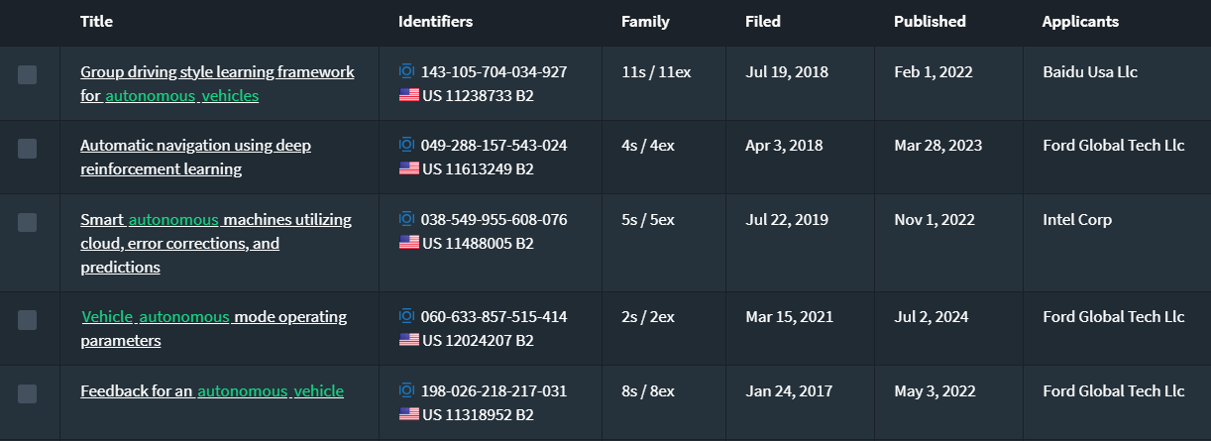
Dataset
Source of the Dataset: lens.org
No. of Observations: 667 patent full-text files
Column/Feature Details: Title, Abstract, Claims, Application Date, Publication Date, Applicants, CPC Codes
Details about the columns – Text data
Screenshot of the dataset:

Slide 12
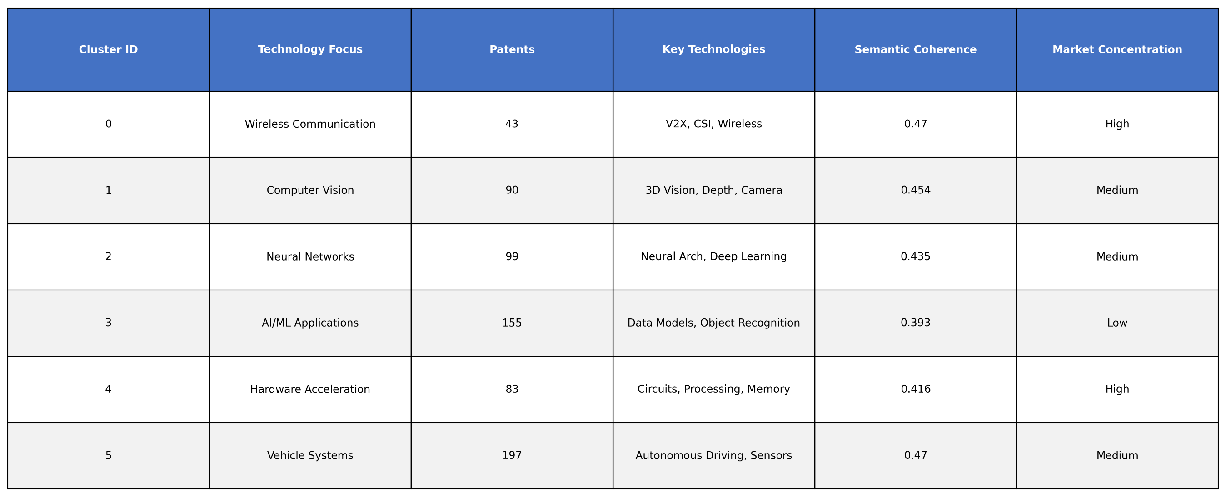
Results and Discussion
Technology Clustering

Slide 13
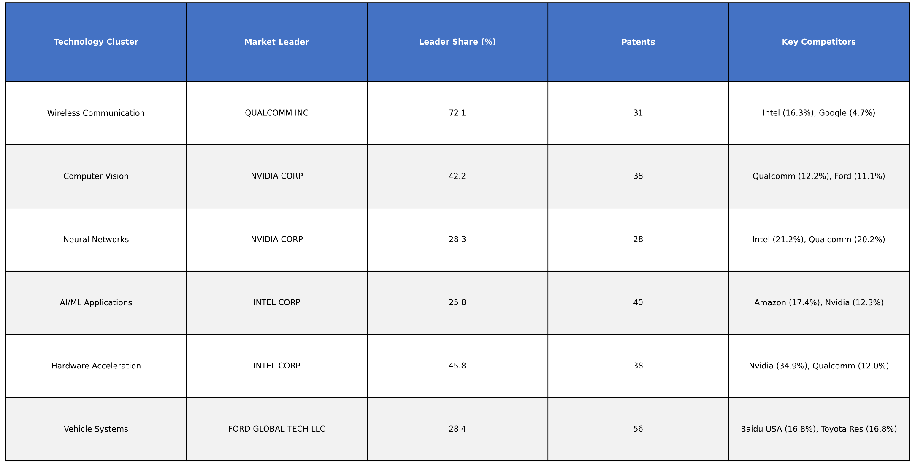
Results and Discussion
Technology Clustering

Slide 14
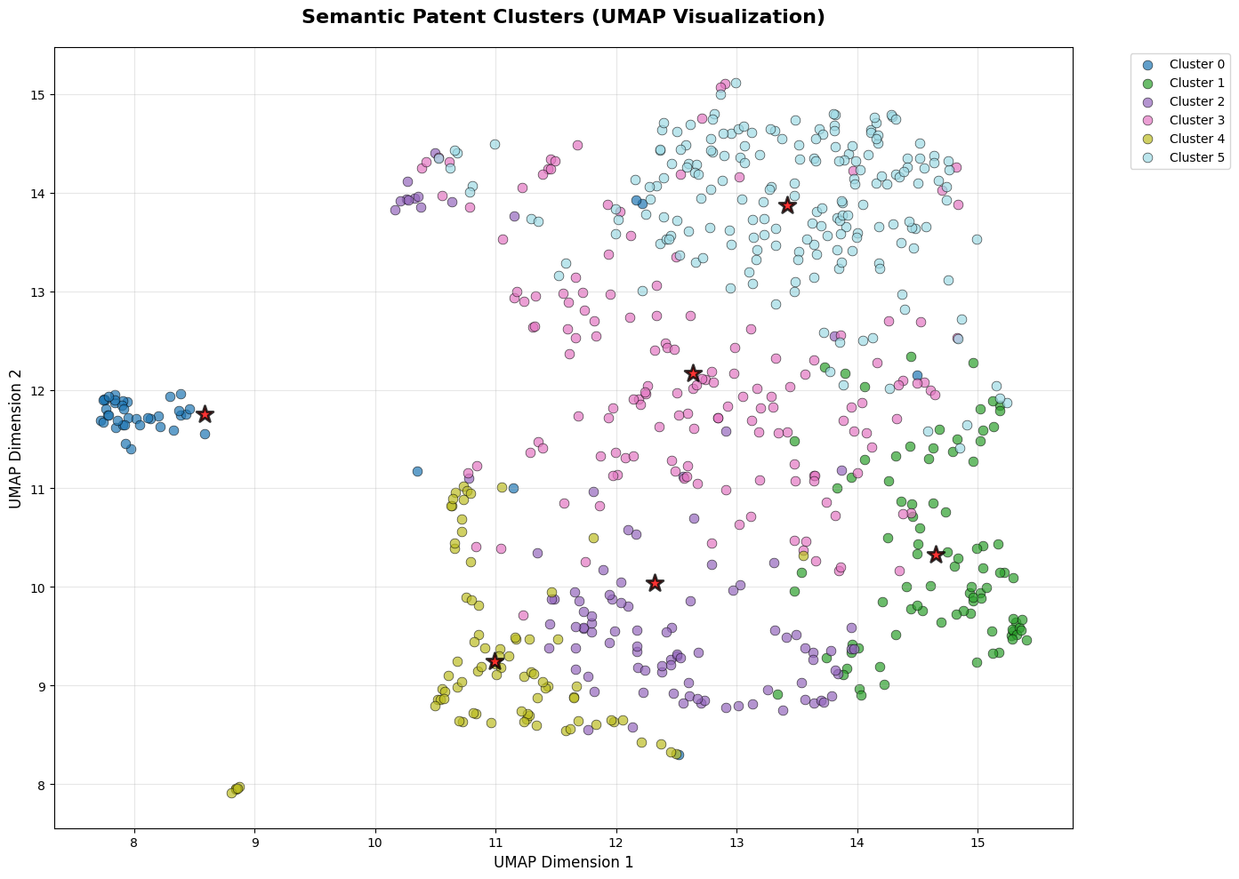
Results and Discussion
Technology Clustering
The UMAP visualization displays distinct, well-separated clusters with minimal overlap, indicating good differentiation between semantic groups of patents, while the presence of some internal scatter within clusters suggests a degree of semantic breadth within each defined topic.

Slide 15
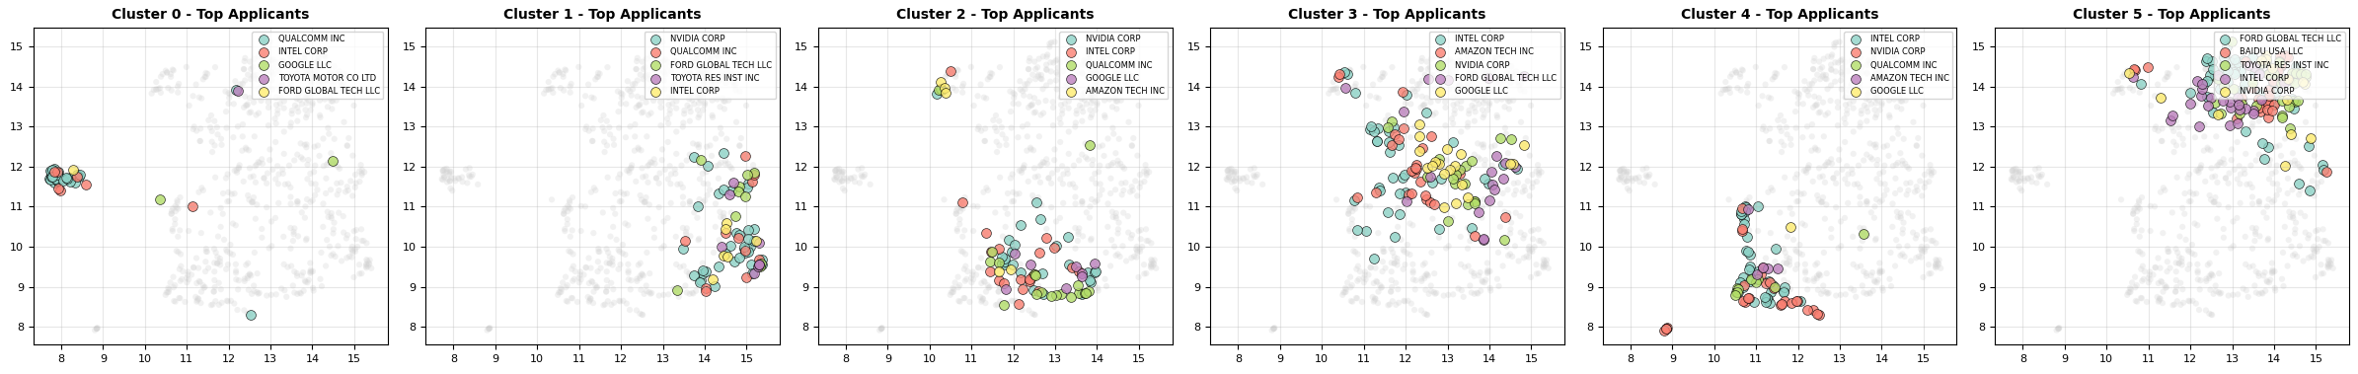
Results and Discussion
Technology Clustering
The multiple UMAP plots reveal that different top applicants (e.g., Intel, Nvidia, Ford) dominate distinct semantic spaces, suggesting specialized innovation focuses across the identified patent clusters.

Slide 16
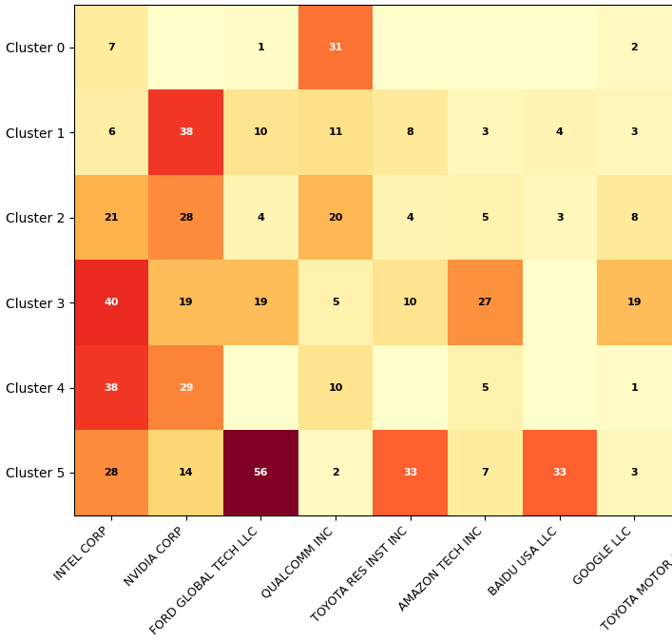


Results and Discussion
Technology Clustering
The heatmap reveals that while Intel and Nvidia are broadly present across multiple clusters, Ford Global Tech LLC exhibits a particularly strong concentration in Cluster 5, and Toyota Research Institute Inc. shows a notable presence in Cluster 0 and 5, suggesting distinct areas of specialized innovation for different applicants.

Slide 17
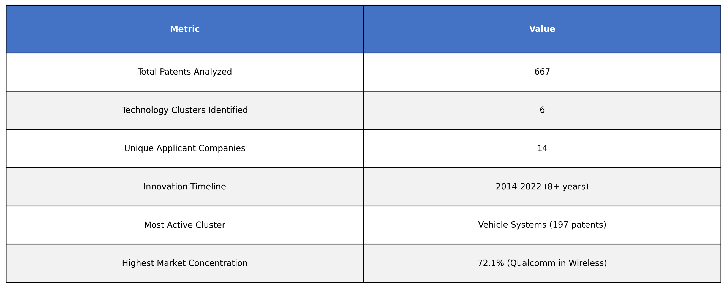
Results and Discussion
Technology Clustering

Slide 18
Results and Discussion
Technology Clustering
• 6 distinct AV technology clusters identified across 667 patents
• Vehicle Systems largest cluster (197 patents, 29.5% of total)
• Intel most diversified player (active in all 6 clusters)
• Wireless & Hardware show highest market concentration
• 8+ year innovation timeline (2014-2022) shows sustained R&D
• Technology areas range from low-level hardware to high-level AI applications

Slide 19
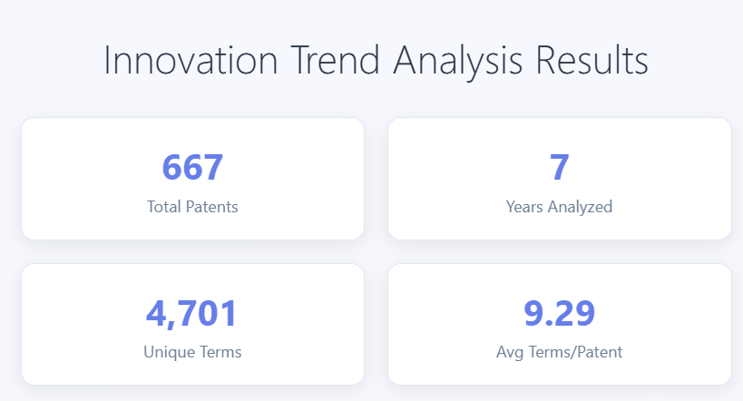
Results and Discussion
Innovation Trend Analysis

Slide 20
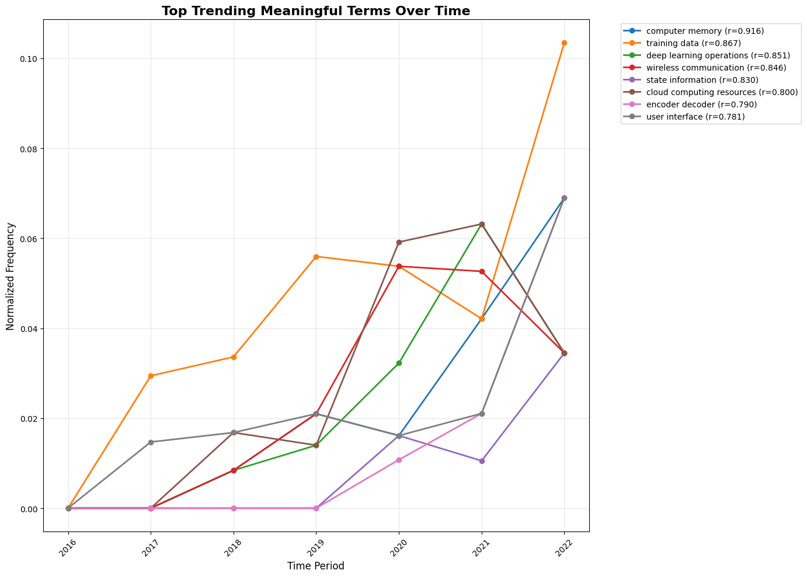
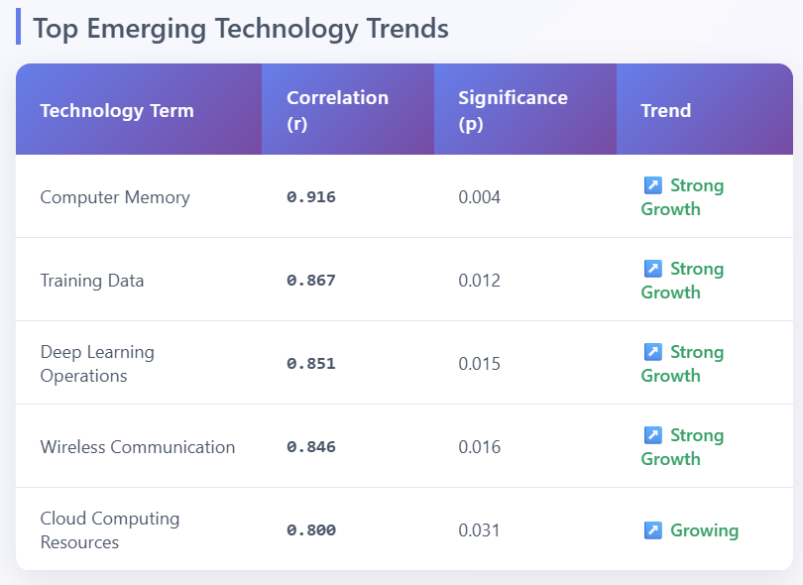
Results and Discussion
Innovation Trend Analysis

Slide 21
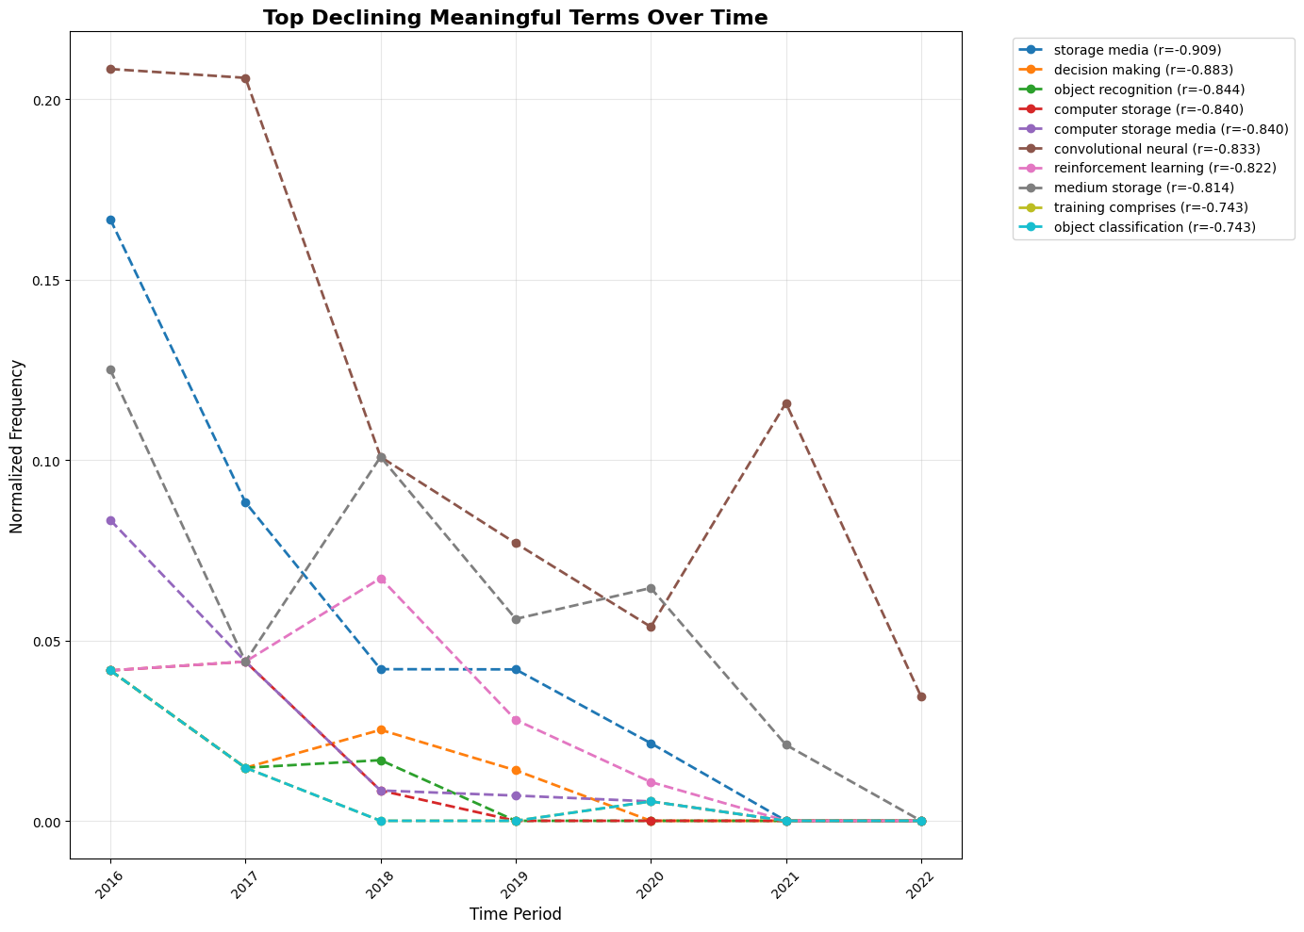
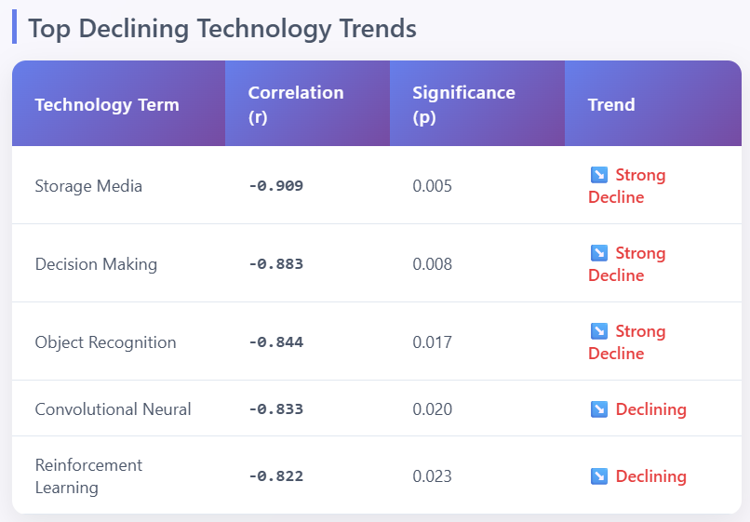
Results and Discussion
Innovation Trend Analysis

Slide 22
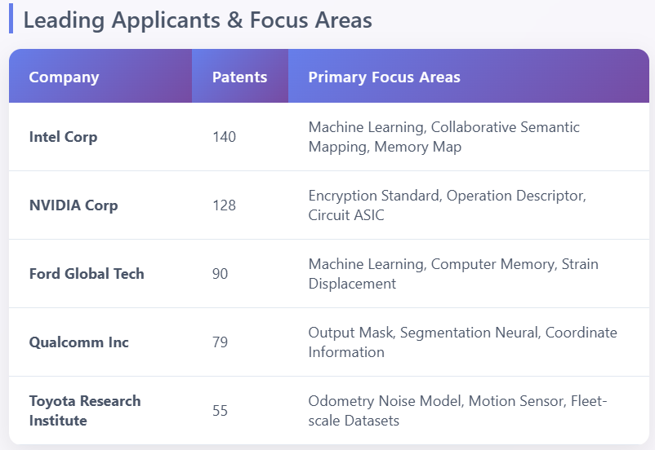
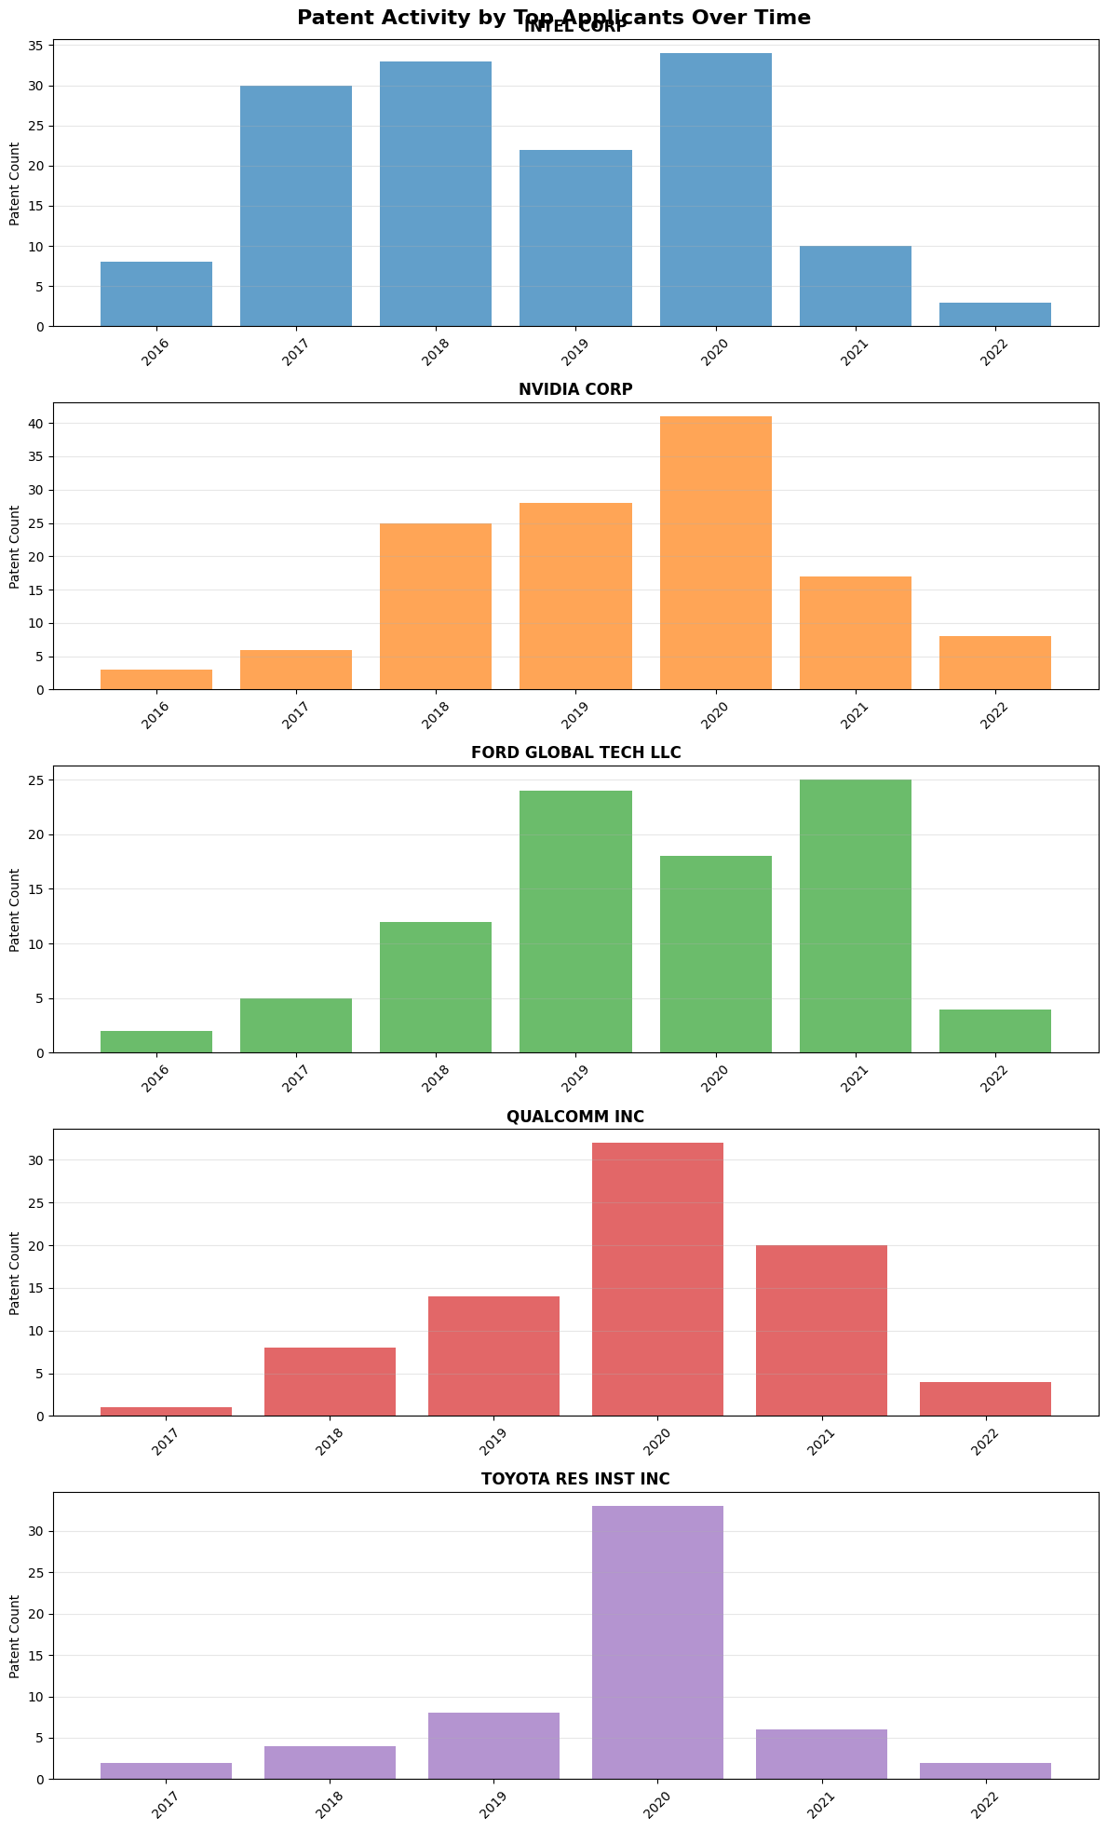
Results and Discussion
Innovation Trend Analysis

Slide 23
Results and Discussion
Innovation Trend Analysis
"Computer memory" and "training data" show strongest growth (r>0.86)
Traditional storage concepts declining as cloud/edge computing rises
Clear shift from basic ML to specialized deep learning operations
Intel and NVIDIA leading with 268 patents combined (40% of total)

Slide 24
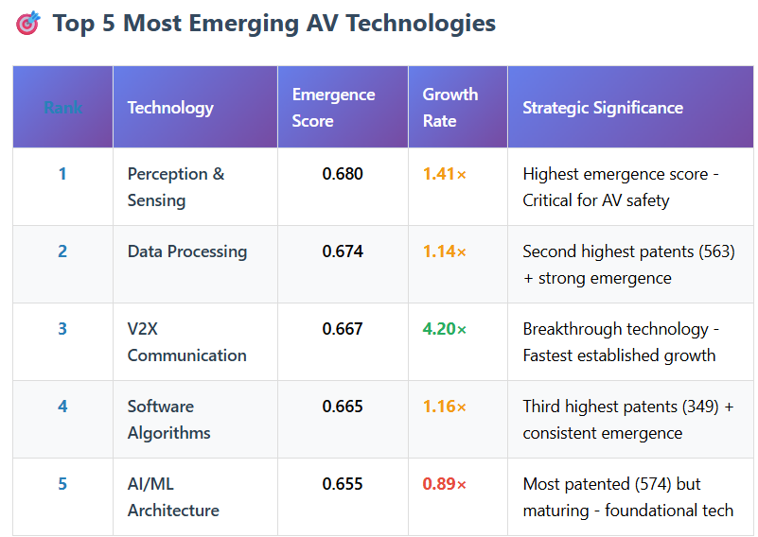
Results and Discussion
Technology Emergence Analysis
The table identifies Perception & Sensing as the most emergent and V2X Communication as the fastest-growing technology, indicating key areas of rapid advancement and strategic importance within autonomous vehicles.

Slide 25
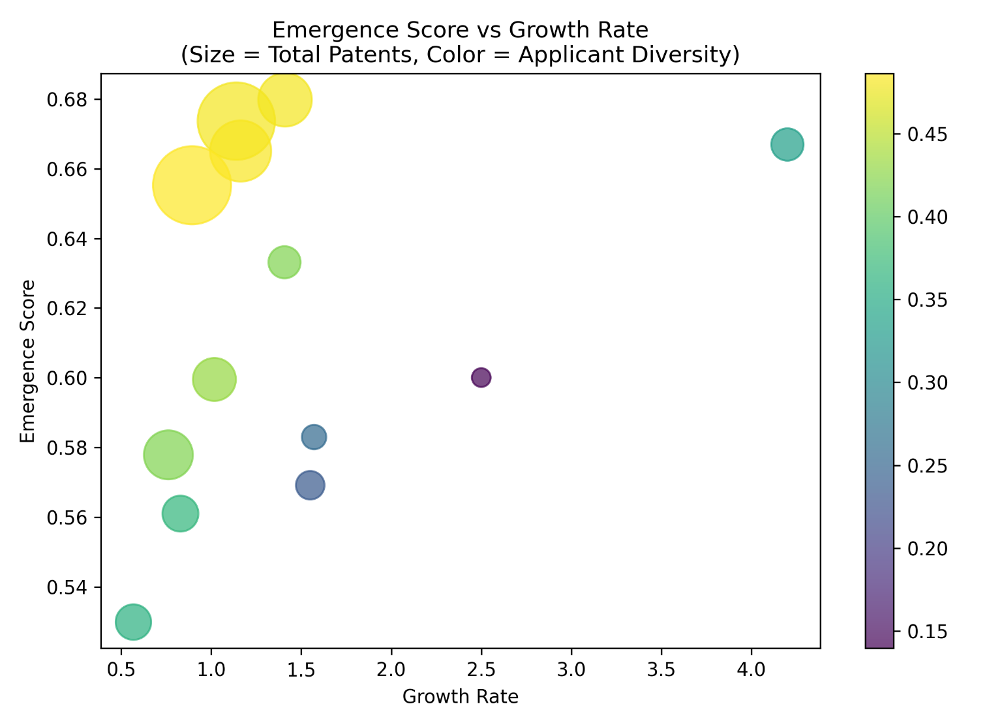
Results and Discussion
Technology Emergence Analysis
The scatter plot illustrates that technologies with higher emergence scores tend to have higher growth rates, and those with more total patents (larger bubble size) and higher applicant diversity (yellowish color) generally occupy the upper-right quadrant, indicating a positive correlation between these metrics.

Slide 26

Results and Discussion
Technology Emergence Analysis
The Quadrant Analysis scatter plot, assessing technologies based on growth rate and applicant diversity, shows a varied distribution where some technologies demonstrate high applicant diversity, while others exhibit higher growth rates but lower diversity.

Slide 27
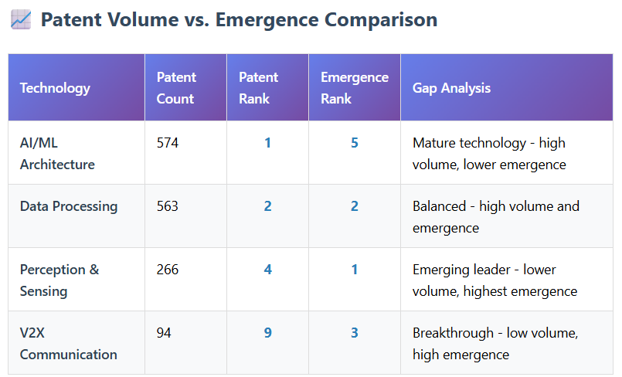
Results and Discussion
Technology Emergence Analysis
The table demonstrates a varied landscape where AI/ML Architecture represents a mature technology with high patent volume but lower emergence, while Perception & Sensing and V2X Communication, despite lower patent counts, are identified as highly emergent and breakthrough technologies, respectively.

Slide 28
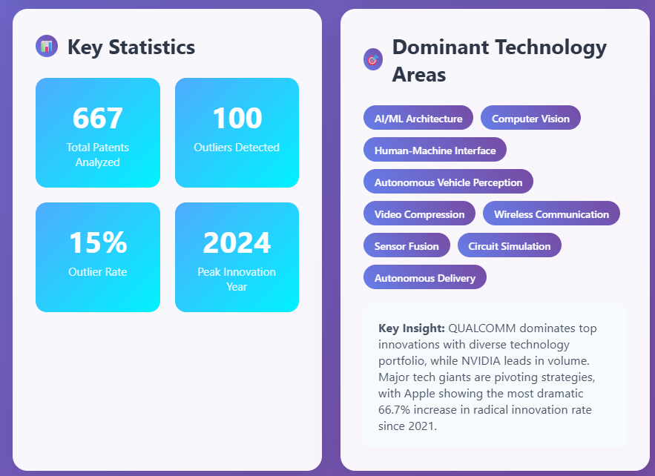
Results and Discussion
Innovation Outlier Detection
The outcome highlights that out of 667 analyzed patents, AI/ML Architecture, Computer Vision, and Autonomous Vehicle Perception are key technology areas, with 2024 being the peak innovation year, and Qualcomm and Nvidia leading in volume and strategic innovation.

Slide 29
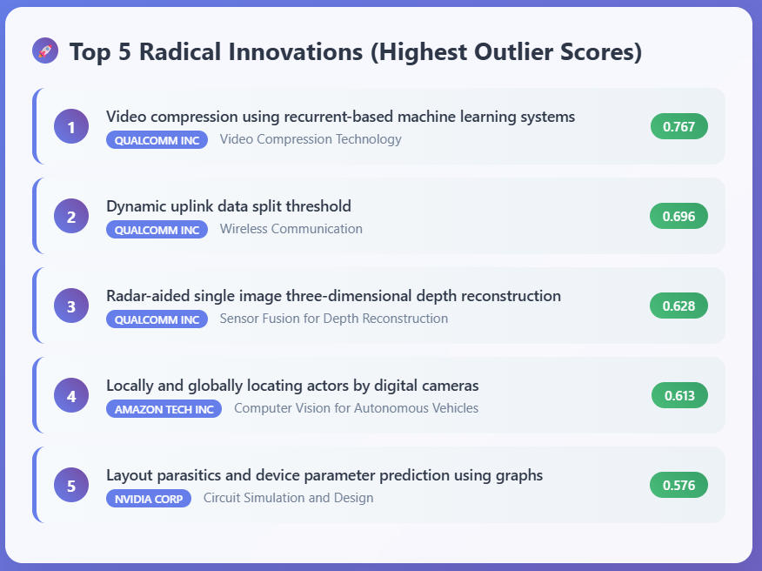
Results and Discussion
Innovation Outlier Detection
The outcome highlights Qualcomm Inc. as a dominant innovator in video compression and wireless communication, along with significant radical contributions from Amazon Tech Inc. in computer vision for autonomous vehicles and Nvidia Corp. in circuit simulation.

Slide 30
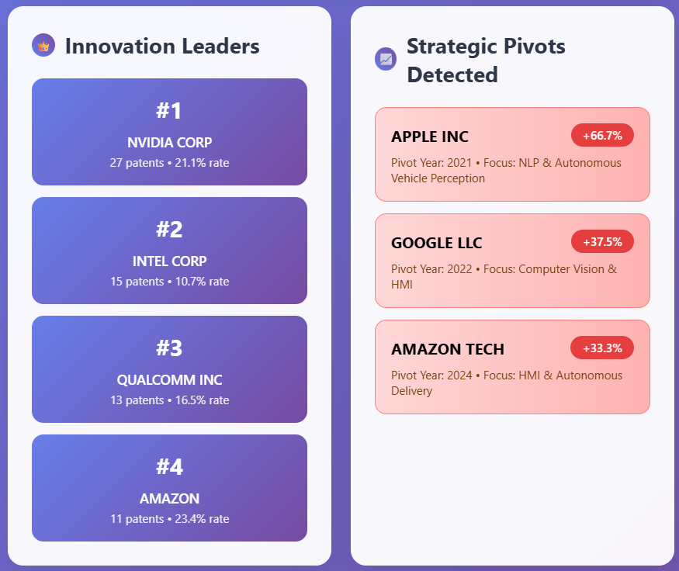
Results and Discussion
Innovation Outlier Detection
The outcome highlights Nvidia Corp. and Intel Corp. as the top patenting entities by volume, while significant increases in strategic pivots are observed for Apple Inc., Google LLC, and Amazon Tech, reflecting their evolving technological focuses.

Slide 31
Conclusion
I successfully analyzed 667 patents from the US autonomous vehicle industry and extracted both broad trends and nuanced insights. Through semantic clustering, I uncovered distinct technological focus areas and identified which companies were leading development within each cluster. Innovation trend analysis helped reveal statistically significant rising and declining technologies, enhanced further through domain-specific curation. By leveraging LLMs, I transformed unstructured patent text into structured formats, enabling a detailed technology emergence analysis. Finally, my outlier detection pipeline highlighted radically innovative patents and strategic pivots by major players. Altogether, this project demonstrated how NLP and machine learning can unlock deep, actionable intelligence from large-scale patent data.

Slide 32
Future Enhancement
Enhance result quality by refining methodologies to reduce noise and improve accuracy in trend and outlier detection.
Develop a more structured and automated pipeline to streamline data handling, analysis, and visualization workflows.
Implement deeper predictive modeling techniques to strengthen technology emergence analysis and provide more forward-looking insights.

Slide 33
References : APA format
Base Paper:
Trappey, A. J. C., Trappey, C. V., Wu, J.-L., & Wang, J. W. C. (2020). Intelligent compilation of patent summaries using machine learning and natural language processing techniques. Advanced Engineering Informatics, 43, 101027. https://doi.org/10.1016/j.aei.2019.101027
Link to Paper
Paper I:
Cho, R. L. T., Liu, J. S., & Ho, M. H. C. (2021). The development of autonomous driving technology: perspectives from patent citation analysis. Transport Reviews, 41(5), 685–711. https://doi.org/10.1080/01441647.2021.1879310
Link to Paper
Paper II:
Kim, G., & Bae, J. (2017). A novel approach to forecast promising technology through patent analysis. Technological Forecasting and Social Change, 117, 228–237. https://doi.org/10.1016/j.techfore.2016.11.023
Link to Paper
Paper III:
Lattimer, B., Chen, P. H., Zhang, X., & Yang, Y. (2023). Fast and accurate factual inconsistency detection over long documents. In H. Bouamor, J. Pino, & K. Bali (Eds.), Proceedings of the 2023 Conference on Empirical Methods in Natural Language Processing (pp. 1691-1703). Association for Computational Linguistics. https://doi.org/10.18653/v1/2023.emnlp-main.105
Link to Paper

